Slide 1
Final Project Shopping system
William Berthouex
SE450 Object-Oriented Software Development
Notes:
NOTE:
To change the image on this slide, select the picture and delete it. Then click the Pictures icon in the placeholder to insert your own image.

Slide 2
Project Overview
GUI
User Authentication
Product Catalogue
Order Processing
Payment Processing
Event Logging

Slide 3
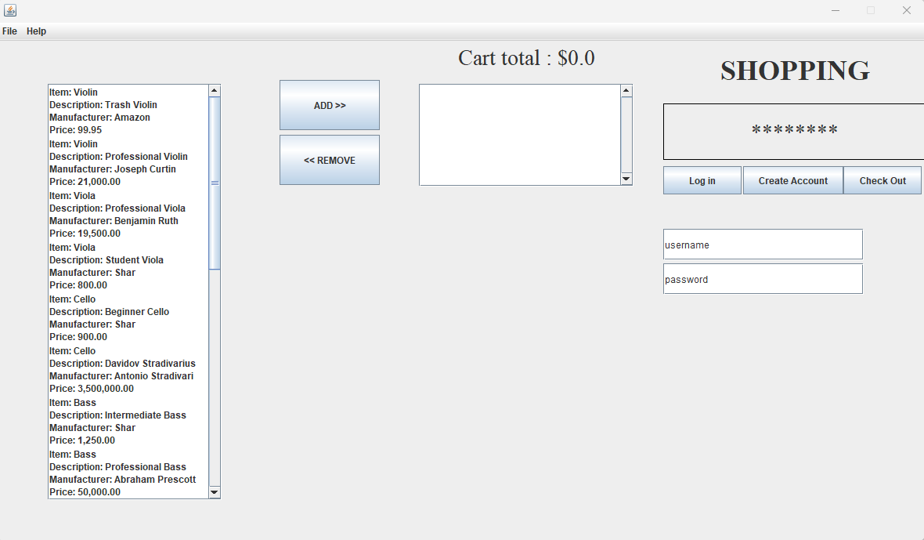
GUI
A simple GUI allows the user to interact with the application.
A user can log in to an existing account, create a new account, or check out a purchase.
Once logged in, a user can add items to their cart and then check out.
Checking out brings up a new window to enter credit card information.
If the credit card passes validation checks, the user receives confirmation of their order.

Slide 4
Event Logging
A LogWriter class records user actions, various methods called by class files, and errors the application encounters.
The LogWriter is implemented as a singleton.
The LogWriter is instantiated in a static block before anything else.
The LogWriter is modeled after the Logger in the java.util.logging package.
The log is stored in a file in the project root directory. This log is not overwritten and subsequent instances of the application will append their logs to the existing log file.

Slide 5
User Authentication
When a user enters a username and password into the corresponding fields in the GUI, the application checks these against a “database” of existing users.
If the username and password match, the user is allowed to log in. A successful login displays the message “Welcome <USERNAME>!” on the GUI.
If there is no match, nothing happens.
If the user opts to create a new account, a new record is added to the user database.
Following best practices, the plaintext password is never stored. Only a hashed password is stored.

Slide 6
Product Catalogue
The Catalogue is implemented as a singleton pattern.
It is instantiated at the start of the application’s runtime.

Slide 7
Payment Processing
A PaymentProcessor class simulates credit card validation.

Slide 8
Order Processing

Slide 9
UML Diagram : Shopping System

Slide 10
Two Content Layout with Table
First bullet point here
Second bullet point here
Third bullet point here
Class | Group 1 | Group 2
Class 1 | 82 | 95
Class 2 | 76 | 88
Class 3 | 84 | 90

Slide 11
Title and Content Layout with SmartArt
Step 1 Title
Task description
Task description
Task description
Task description
Step 2 Title
Task description
Task description
Task description
Step 3 Title
Task description
Task description
Step 4 Title
Task description
Task description

Slide 12
Add a Slide Title - 1

Slide 13
Add a Slide Title - 2

Slide 14
Add a Slide Title - 3

Slide 15
Add a Slide Title - 4

Slide 17
Add a Slide Title - 5

